Slide 1


OCTAGON MANUFACTURING TECHNOLOGY
Special Purpose Machine (SPM) Manufacturing
High-Precision Engineering • Automation • Custom Machinery Solutions
FACTORY ADDRESS:
survey no.576/10, near municipal water tank,wagh dongar,
saswad,tal. Purandar,dist.Pune 412301.

Slide 2
VISION
TO BECOME ONE OF THE MAJOR TECHNOLOGY PROVIDERS FOR RELIABLE AND AFFORDABLE SOLUTIONS FOR THE MANUFACTURING INDUSTRY.
MISSION
WE MAKE STATE OF THE ART RELIABLE AUTOMATIC AND SEMIAUTOMATIC CNC MACHINES TAILORED TO EXCEED EXACT REQUIREMENTS OF THE CUSTOMERS IN INDUSTRY AND DEFENCE SECTOR

Slide 3
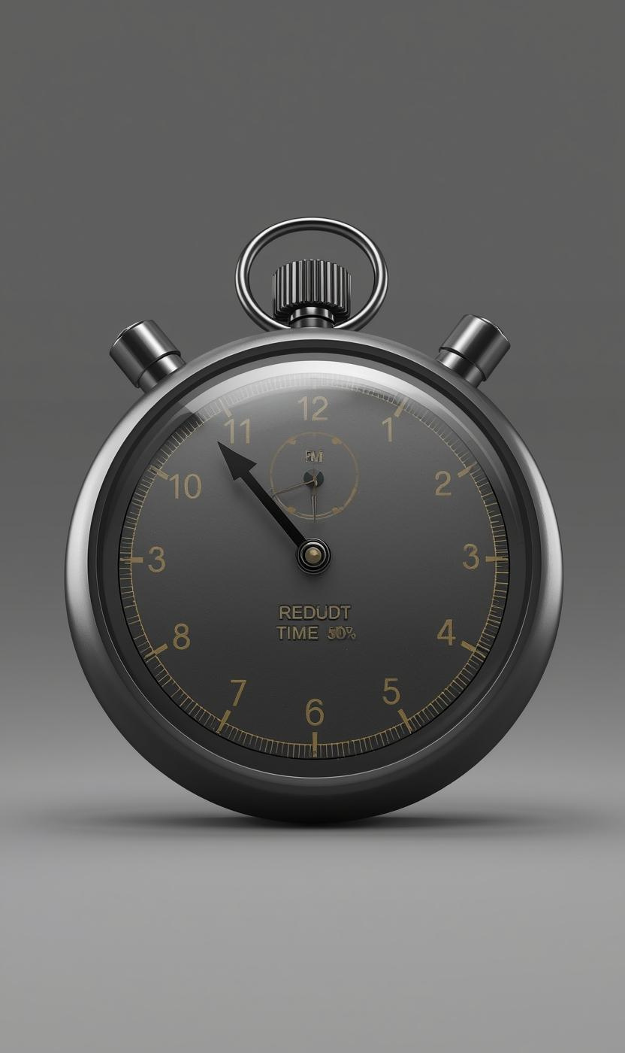
30% – 50%
TIME SAVINGS
By implementing our innovative solutions, we might save you more than 30% to 50% of your valuable production time. This significant reduction in time not only improves efficiency but also enhances overall productivity, allowing your team to focus on what truly matters in the manufacturing process.

Slide 4
INTRODUCTION
Established in the year 2010 at Pune, Maharashtra, We “OCTAGON MANUFACTURING TECHNOLOGY” is a PARTNERSHIP based firm, engaged as the leading manufacturer and service provider of CNC SPM milling machines,CNC drilling machines,CNC twin spindle Gear tooth Chamfering machines and oil hole drilling CNC machine and various types of dedicated application CNC machines. We have in house precision measurement tasks internally, using own specialized tools, equipment.
We are having tie-ups with our vendor who serve us with the best in quality and brand material. Our vendors are only a call away for the service they provide. Our Equipment’s and Machines can be manufactured with different range of materials ranging from EN8, SS 304, SS 316, SS 310, etc. as per the design and requirement.

Slide 5
Product List
Five Axis CNC Precision Drilling And Milling Machine
Twin Spindle Gantry mill CNC Machine
Twin Spindle Gear Chamfering CNC machine
Oil hole drilling CNC machine
Sliding Head CNC machine

Slide 6
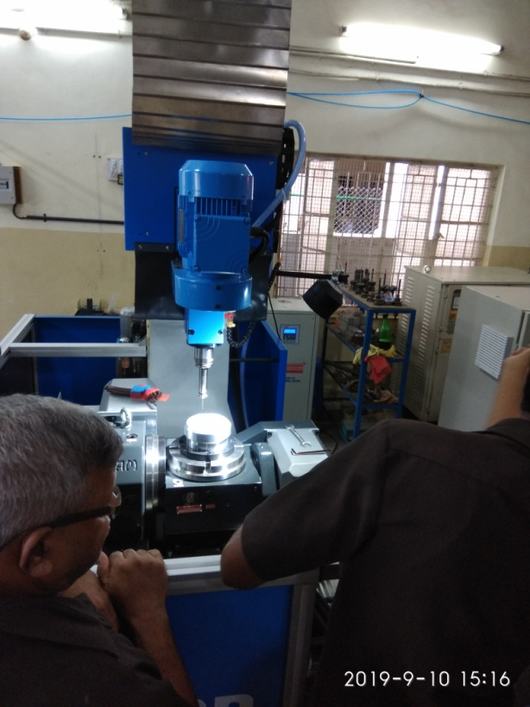
Five Axis CNC Precision Drilling And Milling Machine
Key Features
Multi-axis CNC machines have transformed modern manufacturing.
A 5-axis drilling machine allows simultaneous movement along X, Y, Z and two rotational axes (A, B or C).
Highly suitable for complex, precision drilling tasks.

Slide 7
Technical Overview
Machine Structure-
Axes: X, Y, Z linear axes + A & B rotational axes
Structure: High-rigidity frame for vibration reduction
Key Components
CNC Controller
Spindle (High-speed)
Linear Guide ways & Ball Screws
Coolant & Chip Management System
Fixture/Work holding System
Major Capabilities
Precision Drilling (Inclined & deep-hole drilling)
Thread Milling
Pocketing & Slotting
Multi-plane machining in single setup
High-speed machining of complex profiles

Slide 8
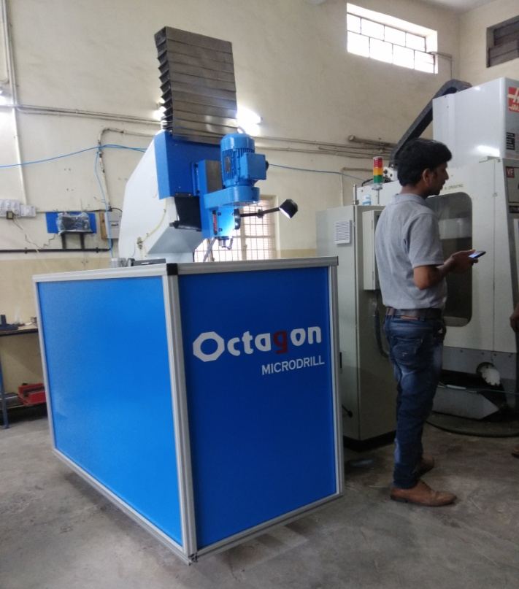
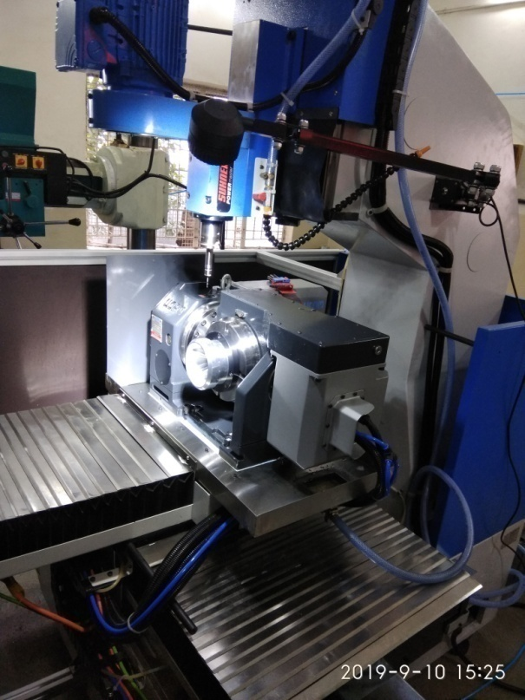
5 AXIS SPM VMC

Slide 9
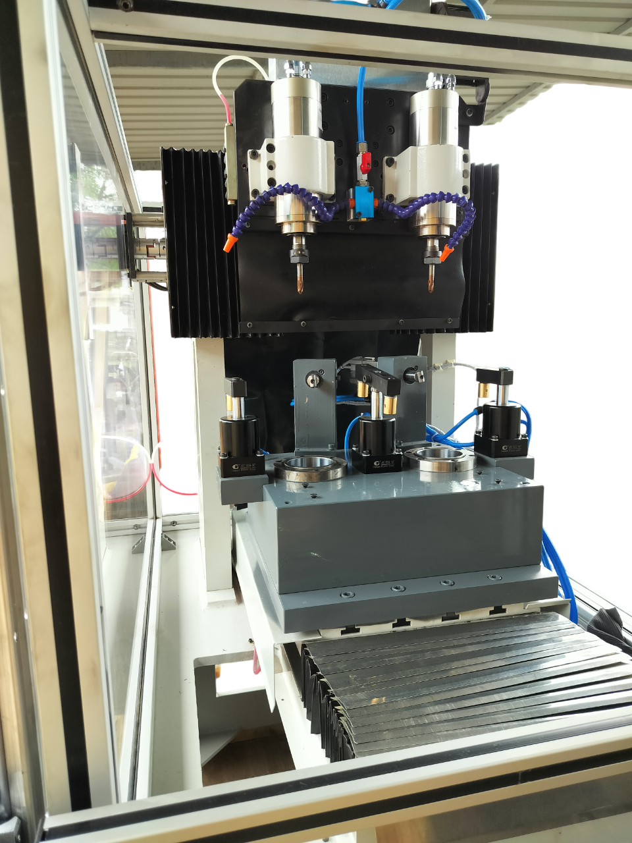
Twin Spindle Gantry mill CNC Machine
Key Features
Bridge-type gantry with dual vertical columns
High rigidity for heavy-duty machining
Large working envelope
Supports 3-axis, 4-axis, or 5-axis configurations
Suitable for roughing and finishing operations

Slide 10
Technical Specifications
Machine Structure-
Design Type: Double-column gantry (fixed or moving bridge)
Guide ways: Linear roller guide ways
Worktable: Oversized table for large components
heavy duty construction.
Variable Speed Capability:
- LM GUIDES AND BALLSCREWS
- SPINDLES SUITABLE FOR PERFORMING THE MILLING
Supports a wide range of spindle speeds for handling everything from roughing passes to fine finishing.
Job Clamping:
hydraulic and pneumatic fixture suitable to hold parts on
stations
Cooling & Lubrication System
Uses controlled coolant flow and lubrication to manage heat, extend spindle life, and maintain accuracy.

Slide 11
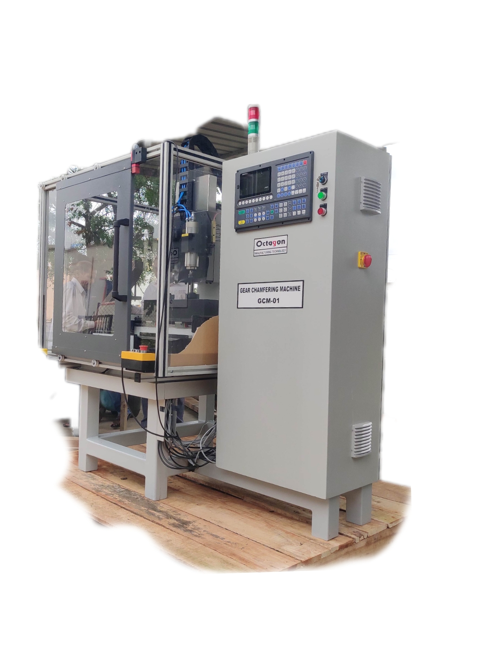
Twin Spindle Gear Teeth Chamfering CNC machine
Key Features-
Adjustable chamfer angles
Suitable for straight edges, curves, and internal/external corners
High precision and smooth finish
Reduces manual effort and time

Slide 12
Technical Specifications
Machine Overview:
Specialized for chamfering & debarring gear teeth
Machine Construction:
Rigid structure for vibration-free operation
Horizontal/vertical head design depending on model
Pneumatic and hydraulic Fixture for holding gears
Chamfering Capability
Spindle water-cooled
Automatic central lubrication system.
variable RPM
precision LM guides and ball screws

Slide 13
Oil Hole Drilling CNC Machine
Machine Overview
Designed for deep-hole drilling, gun drilling, and oil-hole drilling in shafts and rotating components
Suitable for: Automotive crankshafts, camshafts, machine tool spindles, hydraulic cylinders, precision shafts

Slide 14
Technical Specifications
CNC Machine Key Features
Multi-axis CNC control
Precision angle drilling (0°–45° or more)
Deep hole drilling capability
Rigid machine structure for vibration-free drilling
Machine Components
CNC control panel
High-speed drilling spindle
Servo-controlled X, Y, Z axes
Rotational A/B axis (optional)
Hydraulic/pneumatic fixtures
Coolant tank with high-pressure pump

Slide 15
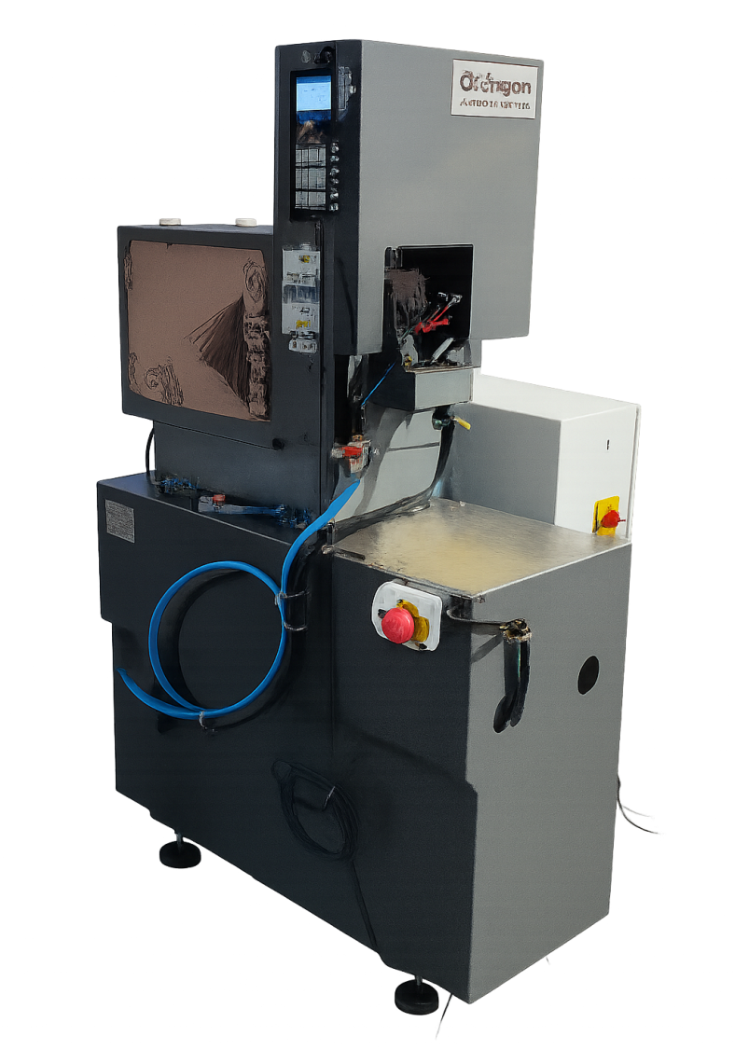
Sliding Head CNC Machine
CNC Sliding Head Machines are advanced turning centers
Also known as Swiss-Type Automatic Lathes
Designed for high-precision, small diameter, long shaft components
Ideal for mass production

Slide 16
Technical Specifications
Main Features
High precision turning
Capability for simultaneous machining
Supports long, slender parts
Fast cycle times
Multiple tools mounted for complex operations
Suitable for continuous production
Key Components
Sliding Headstock
Guide Bush / Guide Bushing
Tool Post / Tool Carrier
Gang-type Tooling System
Bar Feeder
Coolant System
Control Panel (CNC)

